Slide 1
Presentation of Expert Witness Testimony
Federal Bureau of Investigation
Quantico, VA
April 2, 2018
Martin F. Cunniff

Slide 2
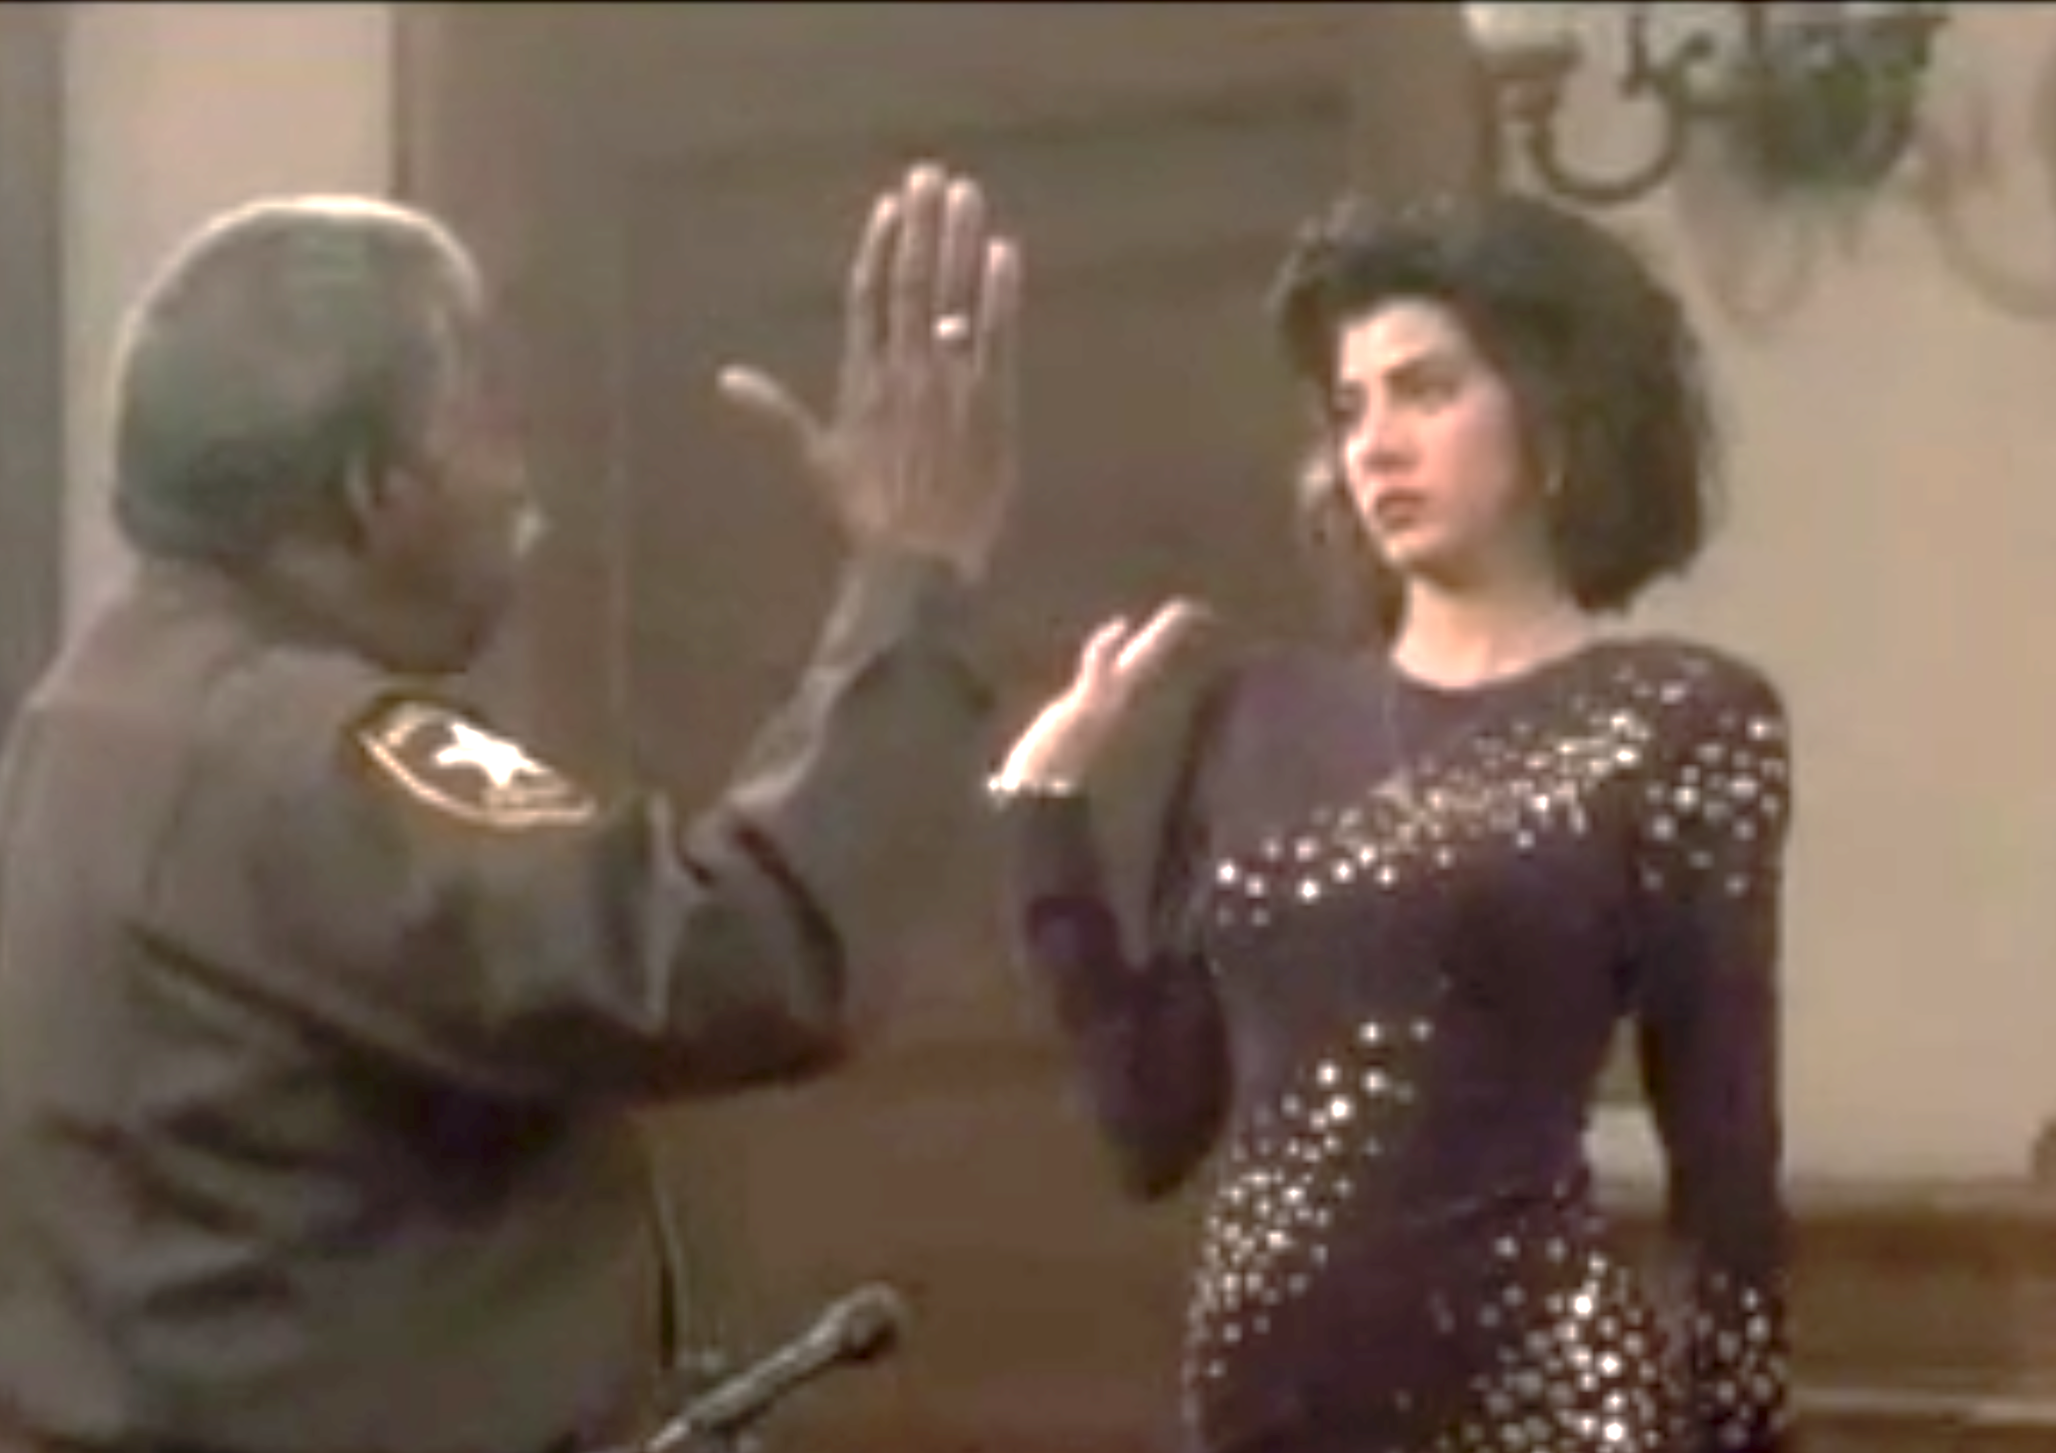
The Truth, the Whole Truth
and Nothing But the Truth

Slide 3
BASICS
4. Settings –
Grand Jury, Trial, Deposition
1. Fact v. Opinion
2. Legal Standards
5. Demeanor – Direct and Cross
3. Purpose

Slide 4

TWO LEVELS
Scientific field, credentials, credibility, experience, judgement, intelligence, personality, values, research, related cases.
Facts, data, hypotheticals, witnesses, evidence, legal standards
Competence
Performance

Slide 5
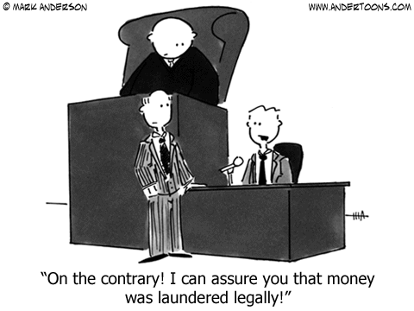

Slide 6
BASIC OUTLINE - DIRECT
1. Introduction
4. Tender
2. Tickler
5. Opinions
3. Qualifying
6. Bases
7. Anticipate Cross Examination

Slide 7
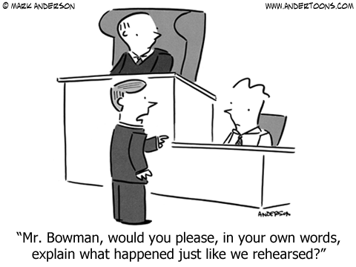

Slide 8
EXHIBITS
Read
Listen
Watch
Touch
Demonstrative
v.
Substantive

Slide 9
CROSS EXAMINATION
Constructive Cross
v.
Destructive Cross
Primary
v.
Recency
Story-Telling
v.
Fact-Gathering
Enlistment
&
Narrowing
Macro
v.
Micro

Slide 10
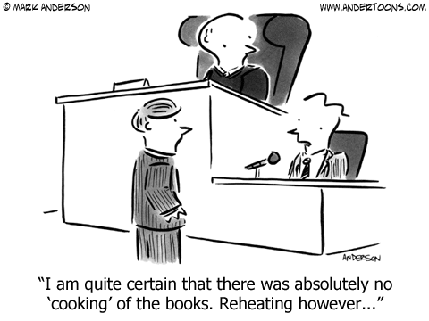

Slide 11
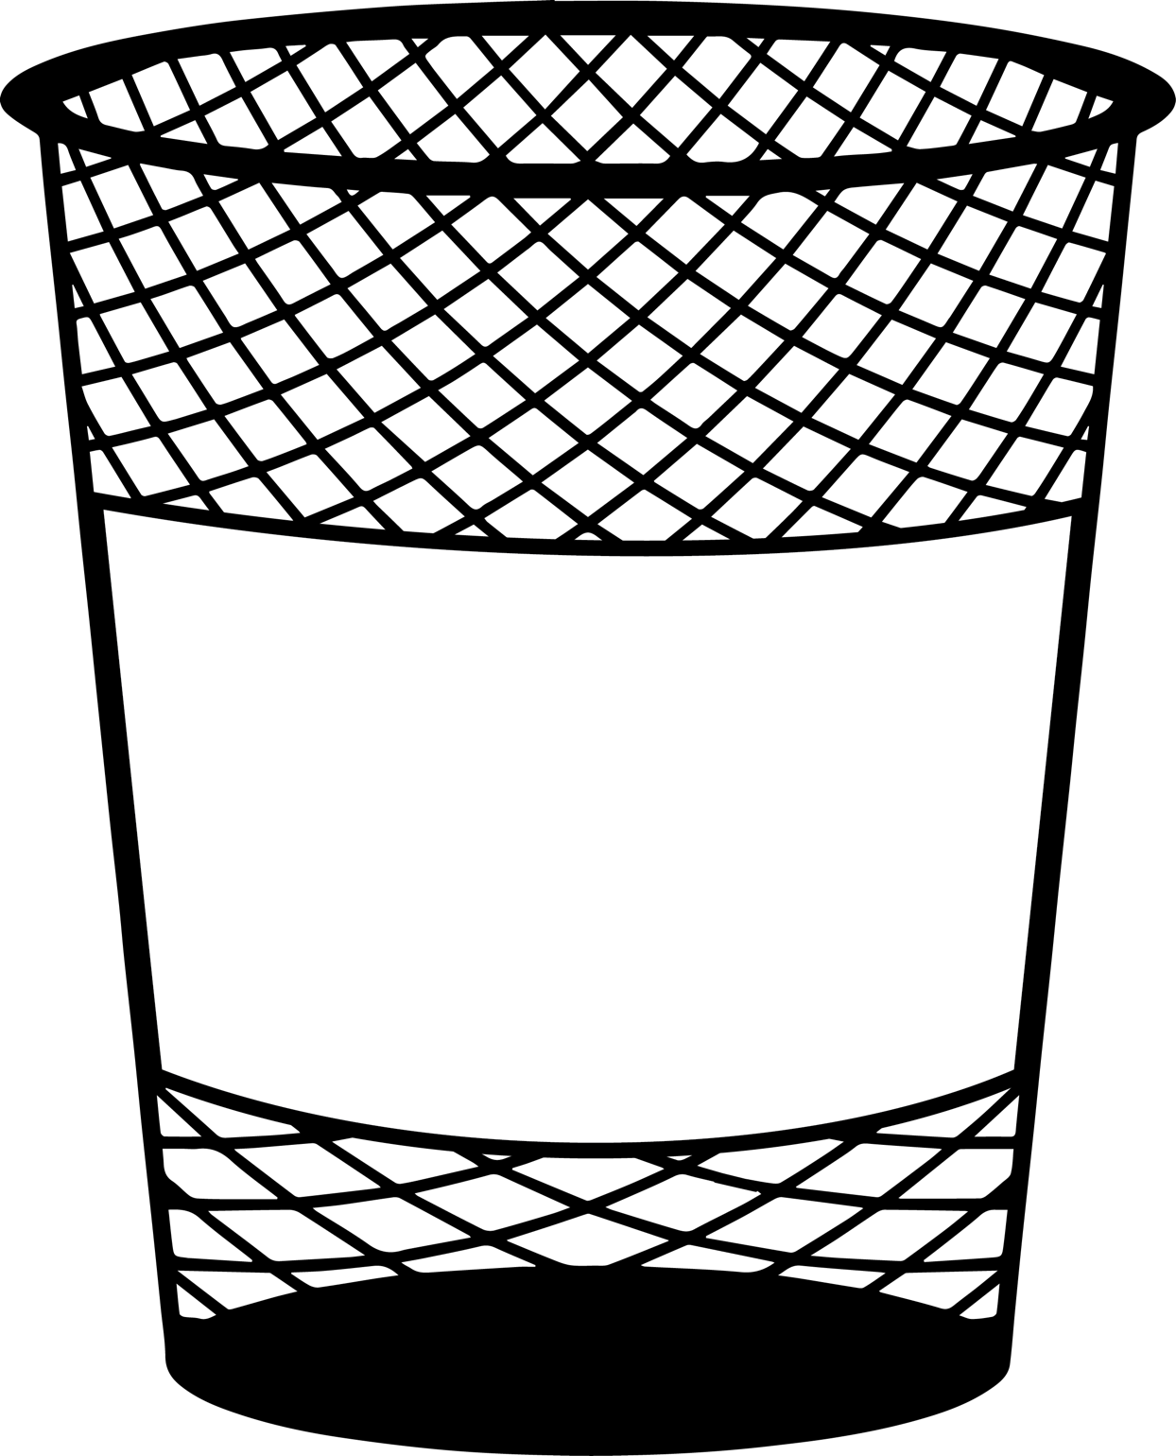
IMPEACHMENT
Prior Inconsistent Statement
Omission
Learned Treatises
Expert’s Report
IMPEACHMENT
Bias
Prior Bad Acts

Slide 12
ANALOGIES & HYPOTHETICALS
Don’t Buy In
Qualify Your Answer
Resist
Make Sure Assumptions
Are Defined

Slide 13

CROSS EXAM TIPS
DO
DON’T
Listen extremely carefully
DON’T
Vary your demeanor from direct
Start with a ‘yes’ or ‘no,’ or flip your answer
Review any exhibit carefully
Anticipate the line of questioning
DON’T
Keep an even keel
Remember there is a redirect examination

Slide 14
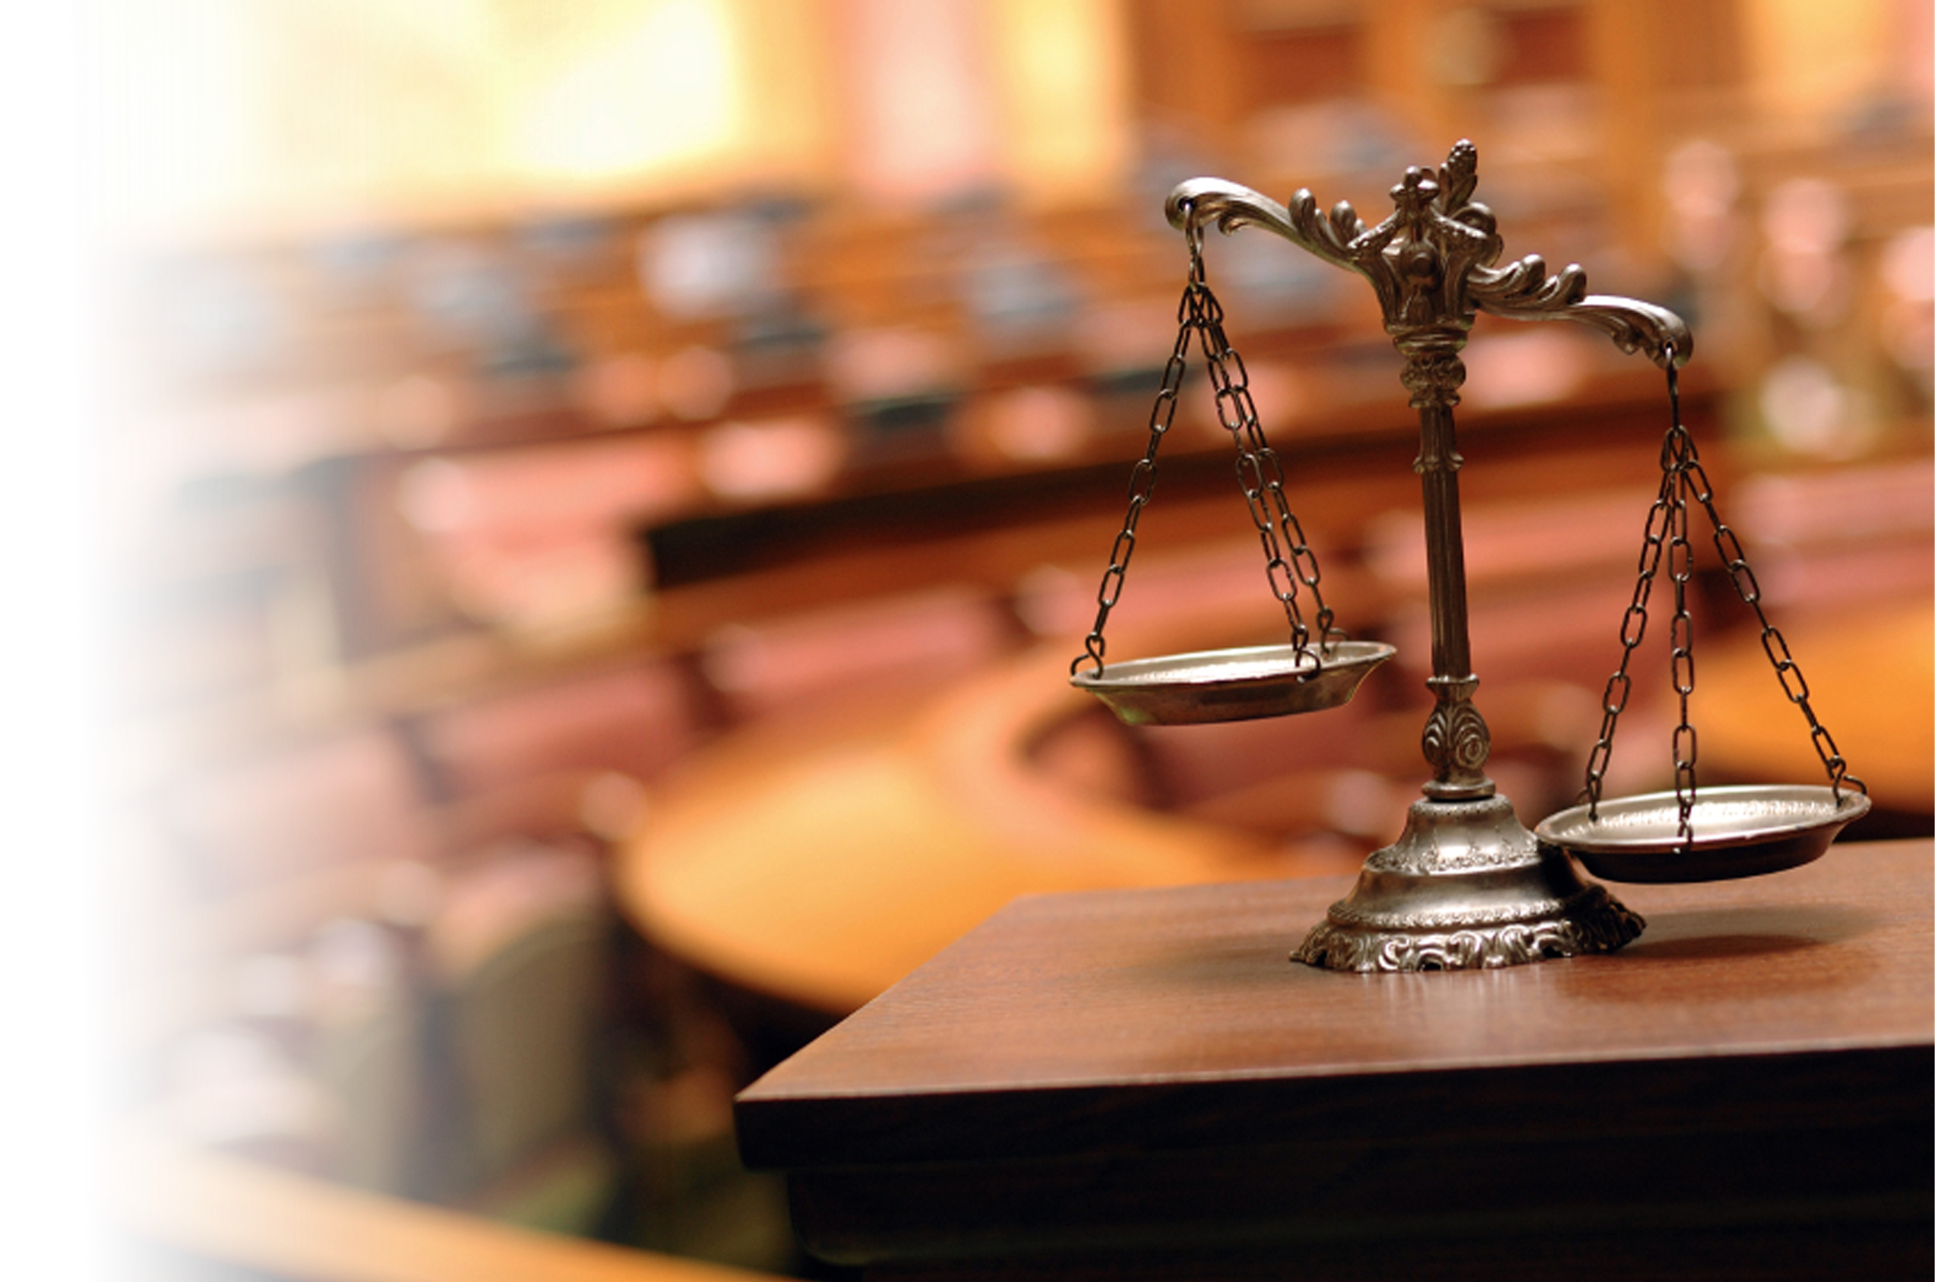
COMMON MISTAKES ON CROSS
Attacking the questioner
Taking it personally
Never giving an inch
Reserving positions
“Can you repeat the question?”
Questioning the cross examiner
Speaking over objections/questions
Making unrelated comments
Opining outside your expertise

Slide 15
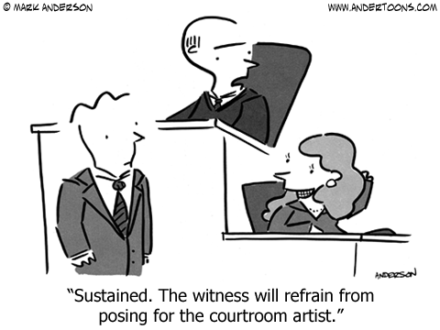

Slide 16
Working with Your Lawyer
It can get lonely on the witness stand, so be careful

Slide 17

WORKING WITH LAWYERS
Don’t Get Pushed
Voice Concerns
Theory of Case
Protected Communication
Draft Possible Cross
Be Cautious Post Swearing In

Slide 18
EXTRA CREDIT PREP
TV/YouTube
Unfamiliar Lawyer
Mock Cross
5th Grader Test
Videotape Yourself

Slide 19
